Slide 1
Wrapper Classes

Slide 2
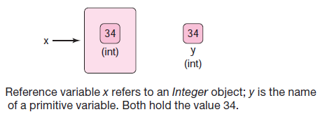
Wrapper Class
A Wrapper class is a class whose object wraps or contains a primitive data types. When we create an object to a wrapper class, it contains a field and in this field, we can store a primitive data types. In other words, we can wrap a primitive value into a wrapper class object.

Slide 3
Need of Wrapper Classes
They convert primitive data types into objects. Objects are needed if we wish to modify the arguments passed into a method (because primitive types are passed by value).
The classes in java.util package handles only objects and hence wrapper classes help in this case also.
Data structures in the Collection framework, such as Array List and Vector, store only objects (reference types) and not primitive types.
An object is needed to support synchronization in multithreading.

Slide 4
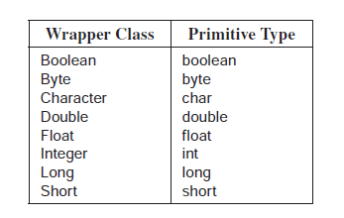
Wrapper Classes in JAVA

Slide 5
Properties of Wrapper Classes
A wrapper class comes packaged with constructors. Except for the Character class, each wrapper class has two constructors.
Each numeric class ( Integer, Long, Short, Byte, Double, and Float ) has a one-argument constructor that accepts an argument of the corresponding primitive type.
Integer(int value) //constructor
Integer integer = new Integer(4); //initialization
Each wrapper class, except Character , has a second constructor that accepts a String argument.
Double x = new Double ("234.56");
Integer y = new Integer("12345");
Boolean z = new Boolean("true");

Slide 6
Continue..
The Character class has a single constructor:
Character(char ch);
Surprisingly, the wrapper classes have no default or 0-argument constructors. So, the statement
Integer x = new Integer(); // ILLEGAL Integer has no default constructor
generates a compilation error.

Slide 7
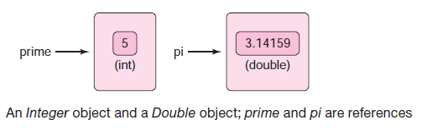
Auto-boxing and unboxing
The automatic conversion of a primitive type to its corresponding wrapper (reference) type is called automatic boxing or simply autoboxing. Similarly, the conversion of a wrapper object to its corresponding primitive type is called automatic unboxing or unboxing. Thus, converting from int to Integer is autoboxing and from Integer to int, unboxing.
Integer prime = 5;
Integer x = 5; // or Integer x new Integer(5). Note that x is a reference.
int y = x; // Notice that x is an object reference and y is a primitive.

Slide 8
Wrappers inherit and Wrappers Implement
The wrapper classes override equals(...) and toString() so that equals(...) compares the values inside two wrapper objects, and toString() returns the value of a wrapper object as a String reference.
Integer x = new Integer(5);
Integer y = new Integer(5);
System.out.println(x.equals(y)); // compares values not references
System.out.println(x.toString());
All wrapper classes, except Boolean, implement the Comparable interface.

Slide 9
Wrappers and Expressions
Conveniently, references to wrapper objects can be used in arithmetic expressions.
Integer x = 10; // x, y, and z are references not primitives;
Integer y = 20;
Integer z = x * y; // Is this multiplication of references?
Although x and y are indeed references, the expression x * y is evaluated as follows:
Variable x is unboxed and its primitive value (10) retrieved.
Variable y is unboxed and its primitive value (20) retrieved.
The value 10 * 20 = 200 is calculated.
A new Integer object with value 200 is instantiated, boxed, and referenced by z
As you can see from this seemingly innocuous code segment, using wrapper references in an arithmetic expression incurs a bit of processing overhead.
“Classes are very convenient when a method requires an object, however, when performing basic arithmetic, opt for primitives.”

Slide 10
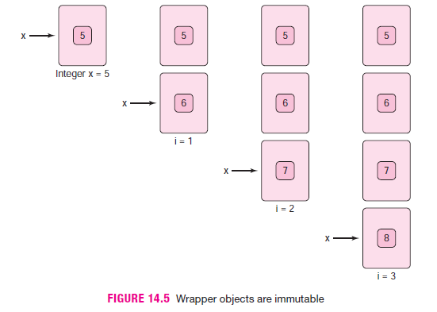
Wrapper Objects are Immutable
Like String objects, an object belonging to a wrapper class is immutable.
Once a wrapper object has been instantiated, its value cannot be changed. Of course, this does not mean that a reference to a wrapper object cannot be reassigned.

Slide 11
Continue..
The wrapper classes override the equals(Object o) method inherited from Object so that a.equals(b) compares values and not references. In contrast, the operator compares references. No unboxing takes place.
Integer x = new Integer(5);
Integer y = new Integer(5); // a second object is instantiated
System.out.println( x == y);
prints
false.
However, it may surprise you that the segment
Integer x = 5;
Integer y = 5;
System.out.println(x == y);
prints
true;

Slide 12
Continue..
In the second case, because Integer objects are immutable, Java deems it unnecessary to create two distinct objects with the value 5. So, in fact, the references x and y both refer to the same object. By not creating two separate objects, the compiler saves memory. Java does this for integer values between 128 and 127, inclusive. If we change the value in the two preceding assignment statements to 555 , then x y evaluates to false. Although autoboxing blurs the line between primitives and wrappers, an Integer is not an int , and an int is not an Integer . Use autoboxing cautiously.

Slide 13
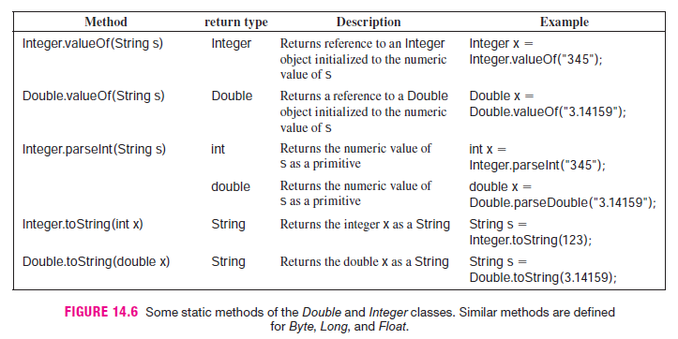
Some Useful Methods
The wrapper classes also implement a number of handy static methods.

Slide 14
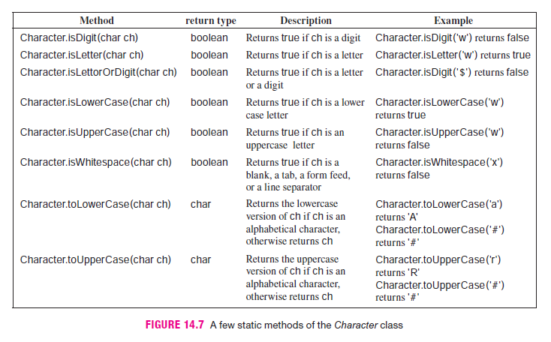
Continue..

Slide 15
Continue..
In addition to the static methods of the wrapper classes, each wrapper class (except Boolean) defines two static constants, MIN_VALUE and MAX_VALUE, that represent the largest and smallest value of the corresponding primitive type.
For example, Integer.MAX_VALUE is 2147483647, Integer.MIN_VALUE is -2147483648, and Byte.MAX_VALUE is 127.

